Slide 1
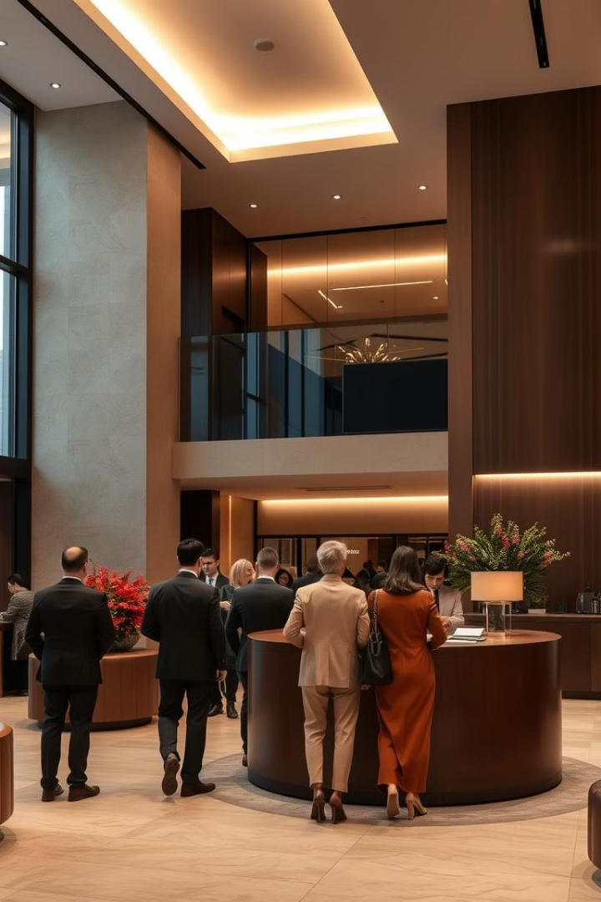
Data Analysis Report For Customer Feedback
This presentation covers an analysis of customer feedback collected from a hotel, focusing on guest experiences across key service areas. We aim to transform raw feedback into actionable insights to support decision-making and improve service quality. The report highlights trends, satisfaction levels, and recommendations for enhancing guest satisfaction and operational performance.
TU
by Toyyib Uthman

Slide 2

Introduction
Data Source
Objective
Customer feedback from hotel guests covering check-in, room cleanliness, food quality, and staff attitude.
Convert raw feedback into structured insights to guide service improvements and decision-making.
Scope
Analysis spans multiple service dimensions to capture a comprehensive view of guest experiences.

Slide 3
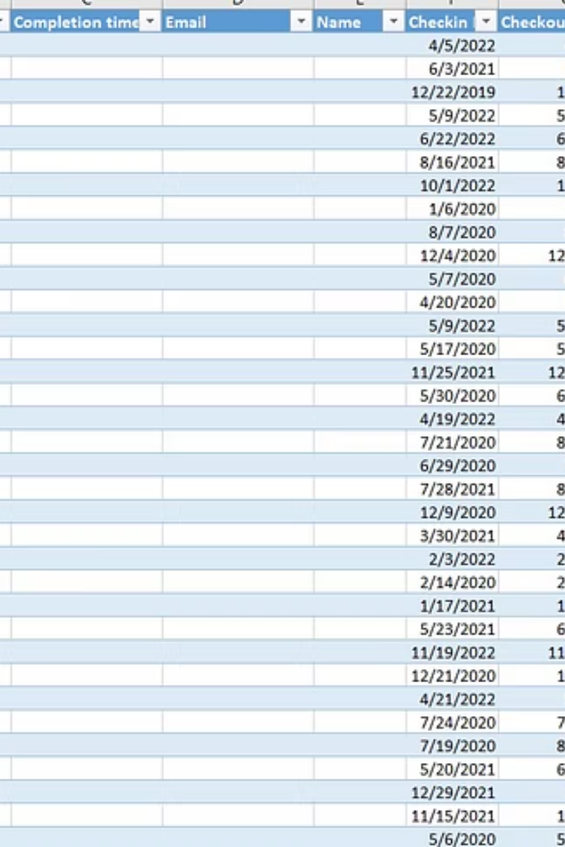
Problem Statement
Challenges
Goals
Raw dataset was unstructured and lacked derived insights.
Extract variables like stay duration and visit patterns.
Quantify qualitative feedback into numerical scores.
Valuable feedback was difficult to aggregate and compare.
Enable dashboard-ready data for clear presentation.
Needed to prepare data for visualization and reporting.

Slide 4
Skills Applied
Data Cleaning & Preprocessing
Feature Engineering
Data Transformation & Pivoting
Created new variables like Year, Month, Stay Duration, and numerical ratings from qualitative inputs.
Removed irrelevant columns, handled missing data, and reformatted dates for consistency.
Encoded text responses into scores and summarized feedback by categories and demographics.

Slide 5
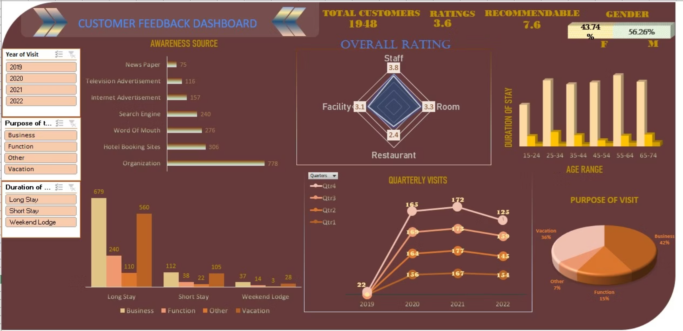
CUSTOMER FEEDBACK DASHBOARD

Slide 6
Insights from the Results
Overall Satisfaction
Service Ratings
The average guest satisfaction score was 3.15 out of 5, indicating moderate satisfaction.
Staff attitude scored highest at 3.76.
Room services rated fairly at 3.29.
Long stays were most common, suggesting guests experienced many hotel services.
Restaurant experience was lowest at 2.43, needing improvement.
Facilities scored moderately at 3.10.
Satisfaction slightly declined from 2019 to 2022, warranting review.

Slide 7





Recommendations
Enhance Restaurant Offerings
Revise menu, improve food quality, and train dining staff to boost ratings.
Regular Staff Training
Maintain and improve high staff performance through ongoing training and incentives.
Customer Follow-up
Implement post-stay feedback loops to address dissatisfaction promptly.
Facility Maintenance
Invest in upkeep and upgrades to sustain guest satisfaction with amenities.
Monitor Trends
Use dashboards for periodic reviews to track satisfaction and respond proactively.

Slide 8

Conclusion
Data Transformation
Cleaning and feature engineering enabled deeper insight into guest feedback.
Key Findings
Moderate overall satisfaction with food quality as a key improvement area.
Future Actions
Implement recommendations to enhance guest experience and strengthen hotel reputation.

